Slide 1


Inclusive Employment
Notes:
‹#›

Slide 2
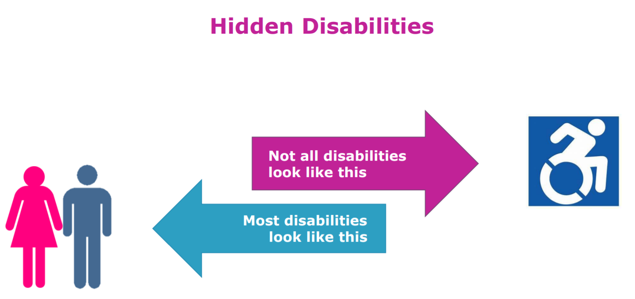
Notes:
‹#›

Slide 3
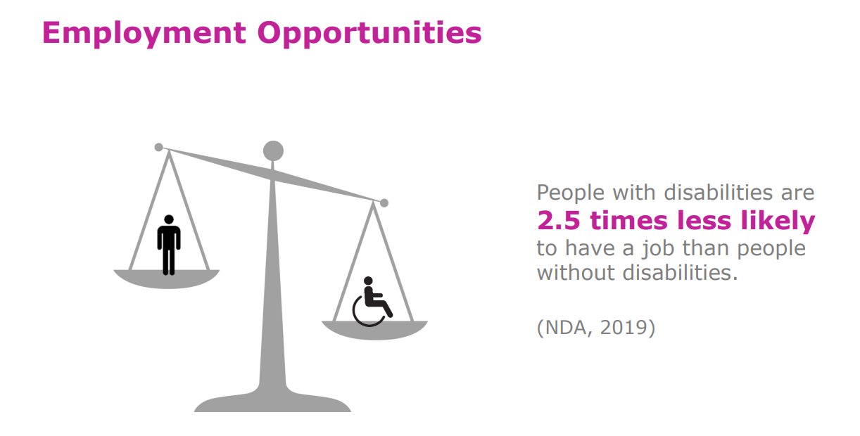
Notes:
‹#›

Slide 4
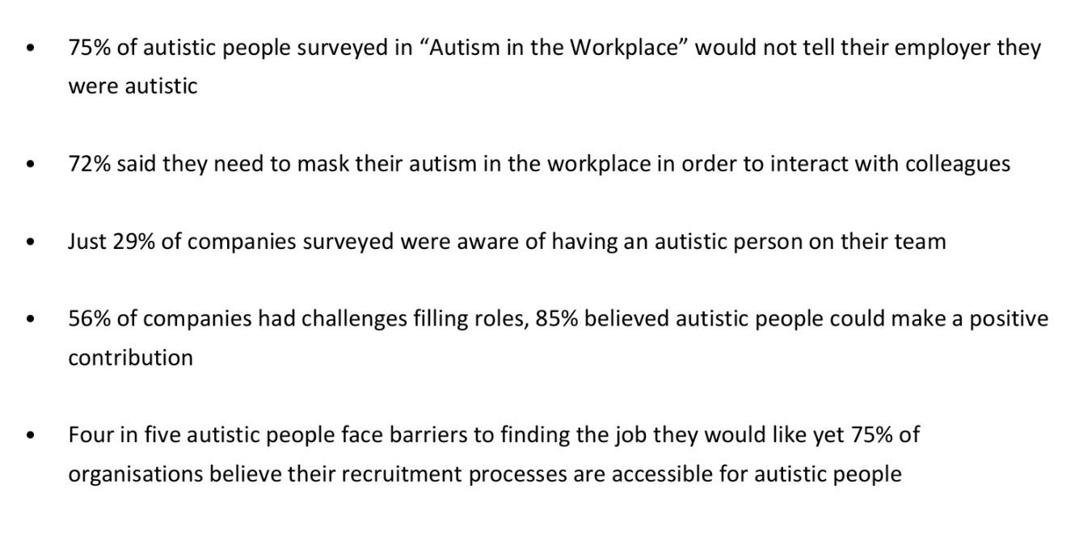
Notes:
‹#›

Slide 5
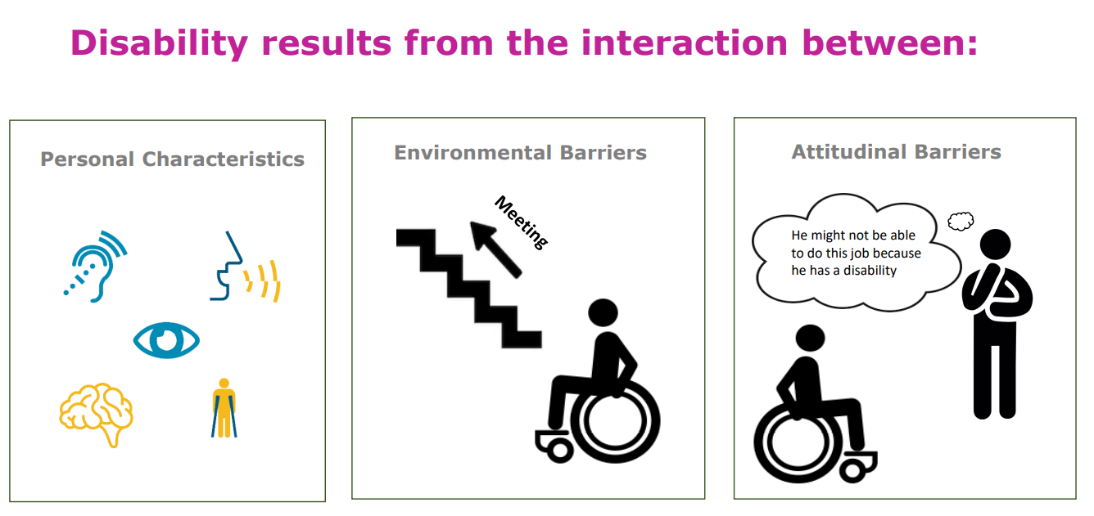
Notes:
‹#›

Slide 6
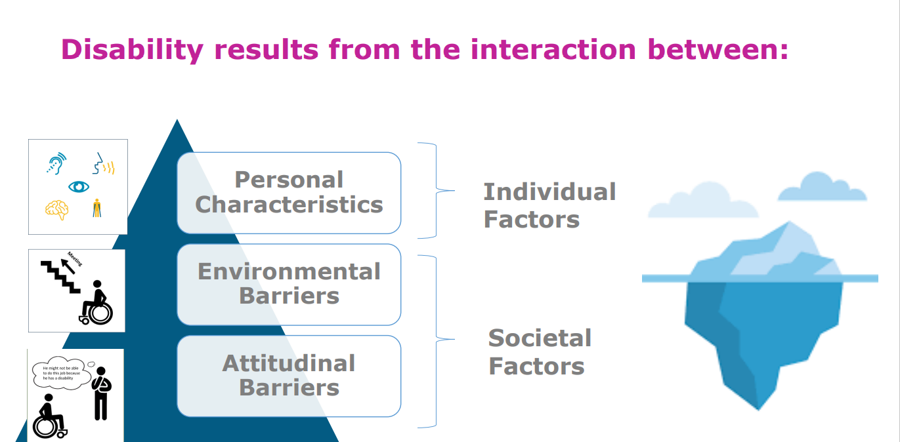
Notes:
‹#›

Slide 7

Notes:
‹#›

Slide 8
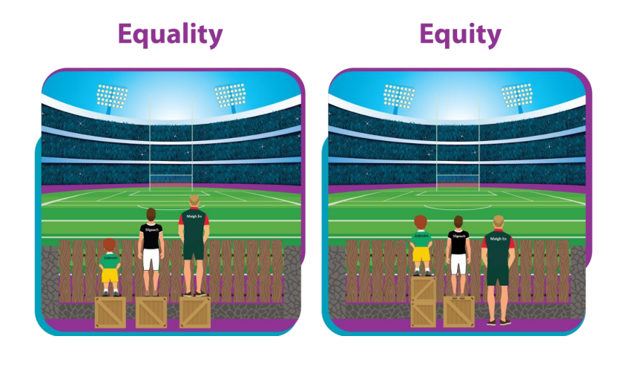
Notes:
‹#›

Slide 9
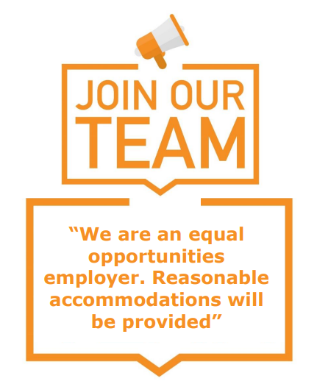
Job Advertising
Make your commitment to diversity clear
Engage in disability recruitment events
Consider use of imagery/font/language
Make it clear exactly what skills you are looking for

Slide 10
Small steps that can make a huge difference in the interview process…
Avoid abstract thinking and hypothetical questions
Make the process clear and unambiguous
Reasonable accommodations – sensory adaptations.
Adopt a strengths based / practical approach to the interview
Consult and prepare ahead of the interview

Slide 11
Environment / Sensory
Be mindful of the waiting area
Ensure there are no irritating noises or smells in the room (including strong perfumes!)
Accept that a person may need to move around, stim or fidget
One person speaking at a time
Consider lighting
Avoid tapping / fiddling etc

Slide 12
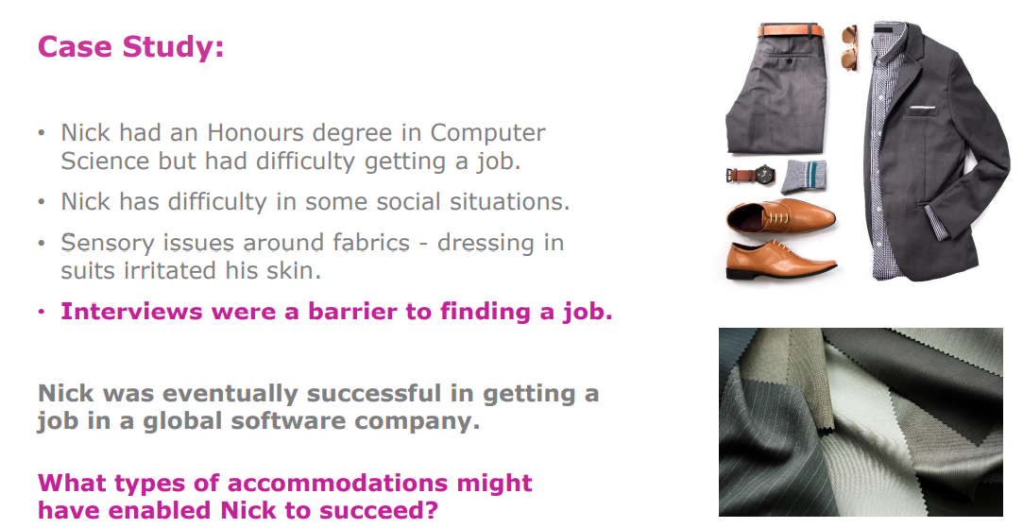

Slide 13
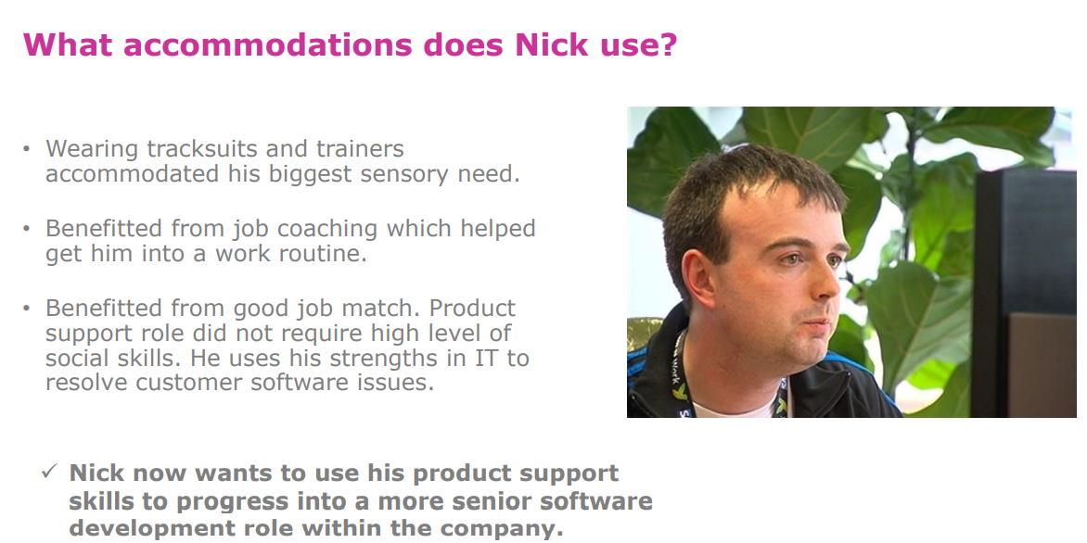

Slide 14
Onboarding and Progression
Whole team/organisation approach to disability awareness training
Discussion of preferred communication style
Person-specific work plan
Agree reasonable accommodations (individual and cultural)
Explain workplace culture/norms/unwritten rules
Mentoring system with progression in mind
‹#›

Slide 15
It’s not charity…
“Everyone has the right to work, to free choice of employment, to just and favourable conditions of work and to protection against unemployment.”
Article 23.1 of the Universal Declaration of Human Rights

Slide 16
Thank you for listening!
Notes:
‹#›

